Slide 1


Advanced Python
TOP ECE Review Center

Slide 2
Topics
Packing and Unpacking Iterables
args and kwargs
Docstring and annotations
Functions (Map, Filter, Zip and Enumerate)
Scopes
Classes
Modules
__name__

Slide 3
Packing and Unpacking Iterables
TOP ECE Review Center

Slide 4
Packing and Unpacking Iterables
Packed values refer to the values that are bundled together in some way.
Tuple ( 1, 2, 3 )
List [ 1, 2, 3 ]
String ‘Hello’
Set { 1, 2, 3 }
Dictionary {‘a’:1, ‘b’:2, ‘c’:3 }

Slide 5
Packing and Unpacking Iterables
Python offers a very powerful assignment tool that maps right hand side arguments into left hand side arguments.
This act of mapping together is known as unpacking of values into a normal variable.

Slide 6
Packing and Unpacking Iterables
Example:
tup1 = ( 1, 2, 3 )
a, b, c = tup1
print(a) // 1
print(b) // 2
print(c) // 3
list1 = [ 1, 2, 3]
a, b, c = list1
print(a) // 1
print(b) // 2
print(c) // 3

Slide 7
Packing and Unpacking Iterables
Example:
str1 = ‘Hey’
a, b, c = str1
print(a) // H
print(b) // e
print(c) // y
set1 = { 1, 2, 3 }
a, b, c = set1
print(a) // 1
print(b) // 2
print(c) // 3
Note: Sets are unordered therefore no guarantees on variable assignments

Slide 8
Packing and Unpacking Iterables
Example:
dict1 = { ‘a’:1, ‘b’:2, ‘c’:3 }
a, b, c = dict1
print(a) // x
print(b) // y
print(c) // z
dict1 = { ‘a’:1, ‘b’:2, ‘c’:3 }
a, b, c = dict1.values()
print(a) // 1
print(b) // 2
print(c) // 3
Note: Dictionaries are unordered therefore no guarantees on variable assignments

Slide 9
Packing and Unpacking Iterables
Example:
dict1 = { ‘a’:1, ‘b’:2, ‘c’:3 }
a, b, c = dict1.items()
print(a) // ( ‘a’:1 )
print(b) // ( ‘b’:1 )
print(c) // ( ‘c’:1 )
Note: The number of variables should equal the number of items

Slide 10
CODING

Slide 11
*args and **kwargs
TOP ECE Review Center

Slide 12
*args and **kwargs
Python has *args which allows us to pass the variable number of non-keyword arguments to function.
def func(a, b):
pass
func(5, 7)

Slide 13
*args and **kwargs
The **kwargs allows us to pass the variable length of keyword arguments to the function.
def func(x, y):
pass
func(x=5, y=7):

Slide 14
*args
Example: Using *args
def adder(*args):
adder(6)
total = 0
// 6
for n in args:
adder(6, 9)
total = total + n
// 15
print(total)
adder(6, 9, 10)
// 25

Slide 15
**kwargs
Example: Using **kwargs
def myfunc(**kwargs):
for k, v in kwargs.items():
print(k, v)
myfunc(a=1, b=2, c=3)
// a 1
// b 2
// c 3

Slide 16
Docstrings and Annotations
TOP ECE Review Center

Slide 17
Docstrings
Python docstrings are the string literals that appear right after the definition of a function, method, class, or module.
Example:
def square(num):
'''Takes in num, returns its square'''
return num**2

Slide 18
Annotations
Function annotations are arbitrary python expressions that are associated with various part of functions.
These expressions are evaluated at compile time and have no life in python’s runtime environment.
They take life when interpreted by third party libraries, for example, mypy.

Slide 19
Annotations
Format:
def spam(p1 : expression, p2 : expression) -> expression:
expression - the type of the parameters that should be passed or comment or any arbitrary string that can be made use by external libraries in a meaningful way.

Slide 20
Annotations
Example:
def square(num : int) -> int:
return num**2
def quo(n1 : int, n2 : int) -> float:
return n1 / n2

Slide 21
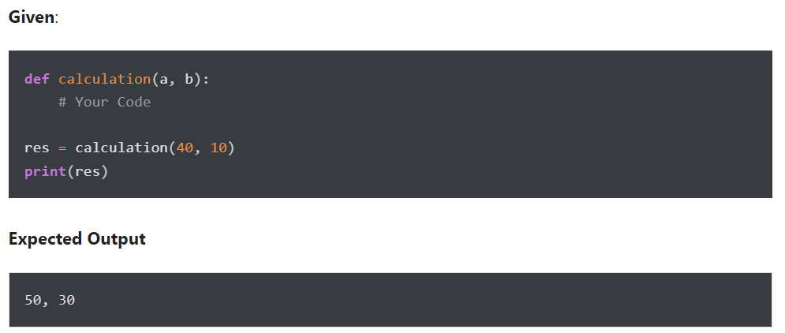
Exercises
Write a program to create a function that takes two arguments, name and age, and print their value.
Write a program to create function calculation() such that it can accept two variables and calculate addition and subtraction. Also, it must return both addition and subtraction in a single return call.

Slide 22
Exercises
Write a program to create a function that takes two arguments, name and age, and print their value.
# demo is the function name
def demo(name, age):
# print value
print(name, age)
# call function
demo("Ben", 25)

Slide 23
Exercises
2. Solution
def calculation(a, b):
addition = a + b
subtraction = a - b
# return multiple values separated by comma
return addition, subtraction
# get result in tuple format
res = calculation(40, 10)
print(res)

Slide 24
map function
TOP ECE Review Center

Slide 25
map function
The map function takes in a function and a list
The function is called with all the items in the list and a new list is returned which contains items returned by that function for each item.
General Form:
map(function, iterable)

Slide 26
map function Example
numlist = [ 2, 4, 5, 6, 7 ]
sq_list = [ ]
def square(num):
return num**2
for n in map(square, numlist):
sq_list.append(n)
print(sq_list)
// [ 4, 16, 25, 36, 49 ]

Slide 27
map function
Alternative 1: Using list comprehension
numlist = [ 2, 4, 5, 6, 7 ]
def square(num):
return num**2
sq_list = [ n for n in map(square, numlist) ]
print(sq_list)
// [ 4, 16, 25, 36, 49 ]

Slide 28
map function
Alternative 2: Using lambda expression
numlist = [ 2, 4, 5, 6, 7 ]
sq_list = [ n for n in map(lambda num : num**2, numlist) ]
print(sq_list)
// [ 4, 16, 25, 36, 49 ]

Slide 29
map function
Alternative 3: Using list constructor
numlist = [ 2, 4, 5, 6, 7 ]
sq_list = list(map(lambda num : num**2, numlist))
print(sq_list)
// [ 4, 16, 25, 36, 49 ]

Slide 30
filter function
TOP ECE Review Center

Slide 31
filter function
The filter() function takes in a function and a list as arguments.
The function is called with all items in the list and a new list returned which contains items for which the function evaluates True.
General Form:
filter(function, iterable)

Slide 32
filter function: Filter even numbers
numlist = [ 1, 4, 5, 6, 7, 9, 10 ]
even_list = [ ]
def even(num):
return num % 2 == 0
for n in filter(even, numlist):
even_list.append(n)
print(even_list)
// [ 4, 6, 10 ]

Slide 33
filter function
Alternative 1: Using list comprehension
numlist = [ 1, 4, 5, 6, 7, 9, 10 ]
def even(num):
return num % 2 == 0
even_list = [ n for n in filter(even, numlist) ]
print(even_list)
// [ 4, 6, 10 ]

Slide 34
filter function
Alternative 2: Using lambda expression
numlist = [ 1, 4, 5, 6, 7, 9, 10 ]
even_list = [ n for n in filter(lambda num : num % 2 == 0, numlist) ]
print(even_list)
// [ 4, 6, 10 ]

Slide 35
filter function
Alternative 3: Using list constructor
numlist = [ 1, 4, 5, 6, 7, 9, 10 ]
even_list = list(filter(lambda num : num % 2 == 0, numlist))
print(even_list)
// [ 4, 6, 10 ]

Slide 36
zip() function
TOP ECE Review Center

Slide 37
zip() function
The zip() function takes iterables which can be zero or more, aggregates in a tuple, and return it.
General Form:
zip(*iterables)
Parameters:
iterables --> can be built-in iterables like list, string, dict or user-defined iterables

Slide 38
zip() function
Example:
numlist = [ 1, 2, 3 ]
strlist = [ 'a', 'b', 'c' ]
zipped_list = zip(numlist, strlist)
print(list(zipped_list) // [(1,'a'), (2,'b'), (3,'c')]

Slide 39
enumerate() method
TOP ECE Review Center

Slide 40
enumerate() method
The enumerate method adds counter to an iterable and returns it.
General Form:
enumerate(iterable, start=0)

Slide 41
enumerate() method
enumerate(iterable, start=0)
Parameters:
iterable --> a sequence, an iterator, or objects that supports iteration
start (optional) --> enumerate() starts counting from this number. If start is omitted, 0 is taken as start.

Slide 42
enumerate() method
Example:
strlist = [ 'a', 'b', 'c', 'd' ]
enum_list = list(enumerate(strlist, start=1))
print(enum_list)
// [ (1, 'a'), (2, 'b'), (3, 'c'), (4, 'd') ]

Slide 43
Scope
TOP ECE Review Center

Slide 44
Scope
The concept of scope rules how variables and names are looked up in your code.
It determines the visibility of a variable within a code.
The scope of a name depends on the place in your code where you create that variable.
It generally presented using the LEGB rule.

Slide 45
Scope
x = 10
def display( ):
x = 20
return x
print(x)

Slide 46
LEGB
LEGB stands for Local, Enclosing, Global and Built-in scopes
Local
Is the code block or body of any Python function or lambda expression.
This Python scope contains the names that you define inside the function.
Enclosing (or non-local) scope
It is a special scope that only exists for nested functions.
If the local scope is an inner or nested function, then the enclosing scope is the scope of the outer or enclosing function.

Slide 47
LEGB
Global
It is the top-most scope in a Python program, script or module.
This Python scope contains all of the names that you define at the top level of a program or a module.
Built-in Scope
It is a special Python scope that’s created or loaded whenever you a run a script or open an interactive session.
Contains names such as keywords, functions, exceptions and other attributes that are built into Python.

Slide 48
Scope
x = 10
def display( ):
x = 20
def display2( ):
x = 30
return x
return display2()
print(display())

Slide 49
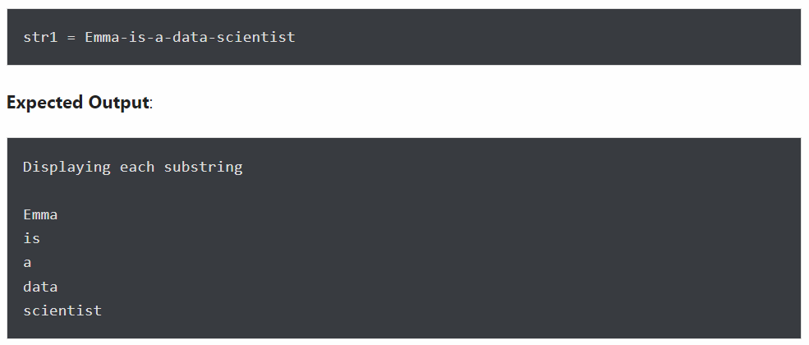
Exercises
Write a program to split a given string on hyphens and display each substring.

Slide 50
Exercises
Write a program to split a given string on hyphens and display each substring.
str1 = "Emma-is-a-data-scientist"
print("Original String is:", str1)
# split string
sub_strings = str1.split("-")
print("Displaying each substring")
for sub in sub_strings:
print(sub)

Slide 51
Part 1: Object Oriented Programming (OOP)
TOP ECE Review Center

Slide 52
Object-Oriented Programming (OOP)
Object-oriented Programming or OOP is a programming paradigm which provides a means of structuring programs so that properties and behaviors are bundled into individual objects.
An Object is simply a collection of data (variables) and methods (functions) that can act on those data.
A class is a blueprint for the object.
An Object is also called an instance of a class and the process of creating this object is called instantiation.

Slide 53


Class in Python
Object
(Instance of a class)
Class
(Blueprint)
CAR
Attributes
Model
Year
Color
Methods
Accelerate
Stop
Steer

Slide 54
Defining a Class in Python
Classes are defined in Python by using a class keyword
Example:
class Car:
pass

Slide 55
Attributes of a Class
Attributes of a class may be data or method.
Methods of an object are corresponding functions of that class
Example:
class Car:
color = 'Blue'

Slide 56
Part 2: Creating an instance of a class (object)
TOP ECE Review Center

Slide 57
Attributes of a Class
class Car:
color = 'Blue’
color is called the class data attribute
Whenever we instantiate the Car class, we can call the class attribute
car1 = Car()
car1.color // Blue

Slide 58
Part 3: Creating a method of an object
TOP ECE Review Center

Slide 59
Methods
Methods are functions in Python and it is bound to an instance of a class.
class Car:
color = 'Blue'
def accelerate(self):
print('vrroomm!')
car1 = Car()
car1.accelerate()
// vrroomm!

Slide 60
Part 4: Initializing an instance of a class
TOP ECE Review Center

Slide 61
Initializing the class
To create instances of a class, you call the class using class name and pass in whatever arguments its __init__ method accepts.
class Car:
color = 'Blue'
def __init__(self, brand):
self.brand = brand
car1 = Car('Ford')
car1.brand
// Ford

Slide 62
Exercises
Write a Python program to create a Vehicle class with max_speed and mileage instance attributes.

Slide 63
Exercises
Write a Python program to create a Vehicle class with max_speed and mileage instance attributes.
class Vehicle:
def __init__(self, max_speed, mileage):
self.max_speed = max_speed
self.mileage = mileage
modelX = Vehicle(240, 18)
print(modelX.max_speed, modelX.mileage)

Slide 64
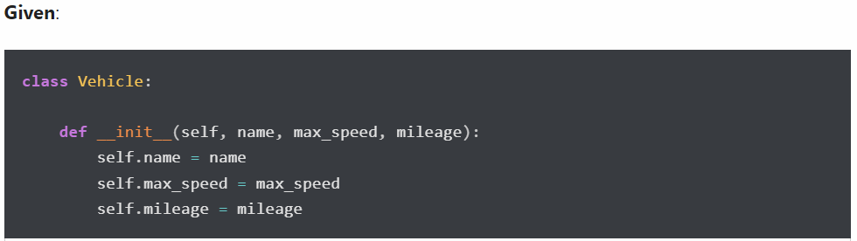
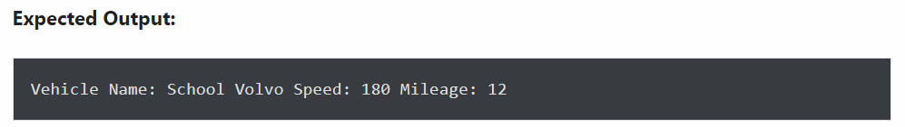
Exercises
2. Create a child class Bus that will inherit all of the variables and methods of the Vehicle class

Slide 65
Exercises
class Vehicle:
def __init__(self, name, max_speed, mileage):
self.name = name
self.max_speed = max_speed
self.mileage = mileage
class Bus(Vehicle):
pass
School_bus = Bus("School Volvo", 180, 12)
print("Vehicle Name:", School_bus.name, "Speed:", School_bus.max_speed, "Mileage:", School_bus.mileage)

Slide 66
Inheritance
TOP ECE Review Center

Slide 67
Inheritance
Inheritance refers to defining a new class with little or no modification to an existing class.
The new class is called derived class and the one from which it inherits is called the base class.

Slide 68
Inheritance
General Form:
class BaseClass:
# body of the base class
class DerivedClass(BaseClass):
def __init__(self):
BaseClass.__init__(self)
# statements

Slide 69
Inheritance Example
class Insect:
def __init__(self):
print('I am an insect')
def crawl(self):
print('I am crawling')
def eating(self):
print('I am eating')
class Ant(Insect):
def __init__(self):
Insect.__init__(self)
print('I am an Ant’)
myinsect = Ant( )
myinsect.crawl( )
// I am an insect
// I am an Ant
// I am crawling

Slide 70
Modules
TOP ECE Review Center

Slide 71
Modules
A module is a file containing Python definitions and statements.
A module can define functions, classes and variables.

Slide 72
Types of Modules
1. Built-in Modules
They come with Python and are part of so called Python Standard Library
Examples of built-in modules:
math, random, os, shutil, subprocess, etc.

Slide 73
Types of Modules
2. External Modules
Modules that are not part of the built-ins and must be downloaded from the Internet
pip is a simple utility that downloads and installs modules and packages at the command line directly from the Internet

Slide 74
Types of Modules
import Statement
Module contents are made available to the caller with the import statement.
The import statement takes may different forms

Slide 75
Forms of import statement
import <module_name>
import <module_name> as <alt_name>
from <module_name> import <name(s)>
from <module_name> import <name> as <alt_name>

Slide 76
__name__
TOP ECE Review Center

Slide 77
__name__
Every module in Python has a special attribute called __name__. The value of __name__ attribute is set to '__main__' when module run as main program.
Otherwise, the value of __name__ is set to the name of the module.

Slide 78
__name__
# pytest1.py
print(__name__)
// __main__
# pytest2.py
import pytest1
// pytest1

Slide 79
__name__
# pytest1.py
def greet():
print('I am from pytest1.py')
if __name__ == '__main__':
print('This is the new program')
greet()
# pytest2.py
import pytest1
pytest1.greet() // I am from pytest1.py

Slide 80
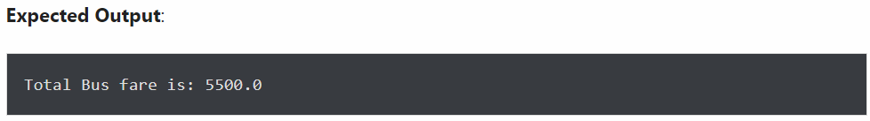
Exercises
Create a Bus child class that inherits from the Vehicle class. The default fare charge of any vehicle is seating capacity * 100. If Vehicle is Bus instance, we need to add an extra 10% on full fare as a maintenance charge. So total fare for bus instance will become the final amount = total fare + 10% of the total fare.
Note: The bus seating capacity is 50. so the final fare amount should be 5500. You need to override the fare() method of a Vehicle class in Bus class.
Use the following code for your parent Vehicle class. We need to access the parent class from inside a method of a child class.

Slide 81
Exercises
class Vehicle:
def __init__(self, name, mileage, capacity):
self.name = name
self.mileage = mileage
self.capacity = capacity
def fare(self):
return self.capacity * 100
class Bus(Vehicle):
pass
School_bus = Bus("School Volvo", 12, 50)
print("Total Bus fare is:", School_bus.fare())

Slide 82
Exercises
class Vehicle:
def __init__(self, name, mileage, capacity):
self.name = name
self.mileage = mileage
self.capacity = capacity
def fare(self):
return self.capacity * 100
class Bus(Vehicle):
def fare(self):
amount = super().fare()
amount += amount * 10 / 100
return amount
School_bus = Bus("School Volvo", 12, 50)
print("Total Bus fare is:", School_bus.fare())

Slide 83
Advanced Python
TOP ECE Review Center

